Slide 1
DevOps
Bridging the Gap Between App Development and User
Patricia Donohue – Build & Release Engineer @ Everi Holdings Inc.

Slide 2
Agenda
Who amI?
Who is Everi?
What is DevOps?
Scenario to get a better idea of what DevOps does
Source Control
Show & Tell
Project – forking a webpage on GitHub

Slide 3
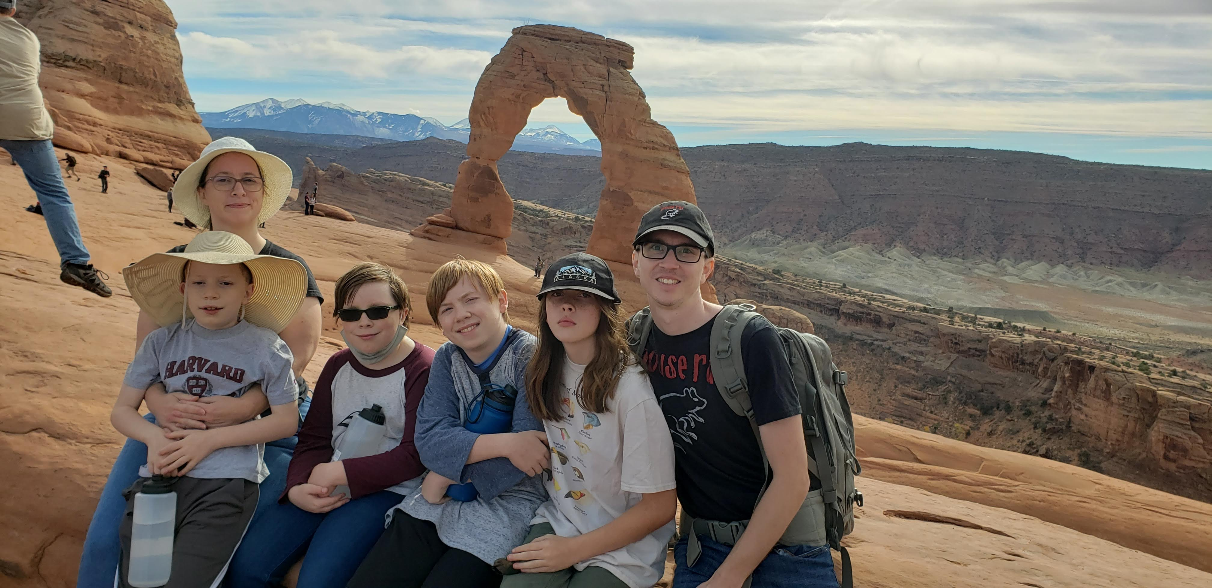
Who am I?
Where I started
Third of eight children
Grew up in Boulder City
Attended CSN for base courses, then went on to UNLV
Dual Baccalaureate in Biology and Biochemistry in 2005
Attended graduate school at UNLV in SOLS, achieved PhD Candidate but never finished
Moved on to a career in IT – starting as an application developer (javascript, database)
Where I am now
Four children, aged 10, 12, and 15
The two 15-year-olds are in different magnet schools in 9th and 10th grade
Build and Release Engineer at Everi, in the process of moving into a DevOps role

Slide 4

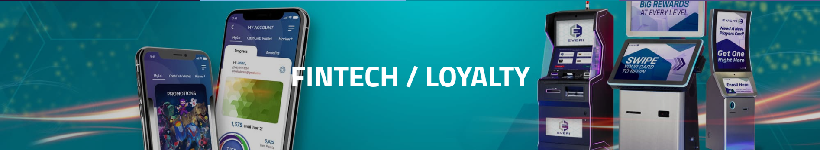
Who is Everi?

Slide 5
What is DevOps?
DevOps (a portmanteau of “development” and “operations”) is the combination of practices and tools designed to increase an organization’s ability to deliver applications and services faster than traditional software development processes. This speed enables organizations to better serve their customers and compete more effectively in the market.
In simple terms, DevOps is about removing the barriers between traditionally siloed teams, development and operations. Under a DevOps model, development and operations teams work together across the entire software application life cycle, from development and test through deployment to operations.
But what does that mean, really?

Slide 6
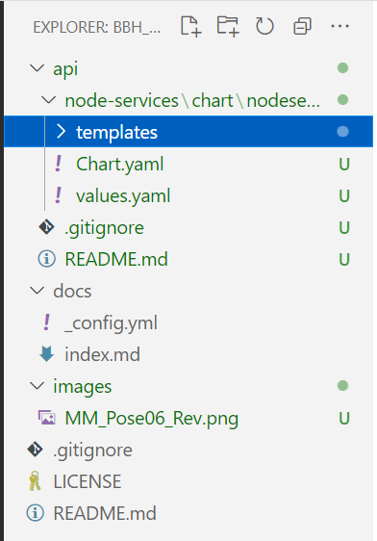
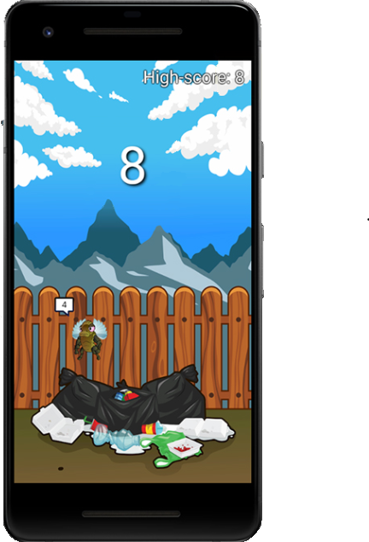
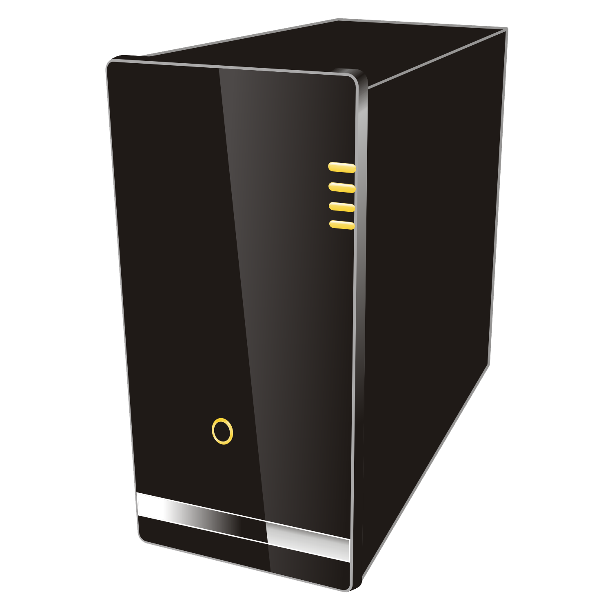


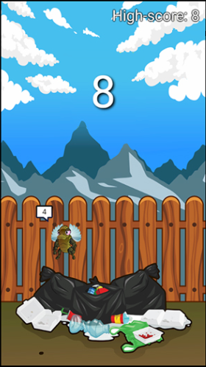
You’ve created your own app!
Development
SysOps

Slide 7
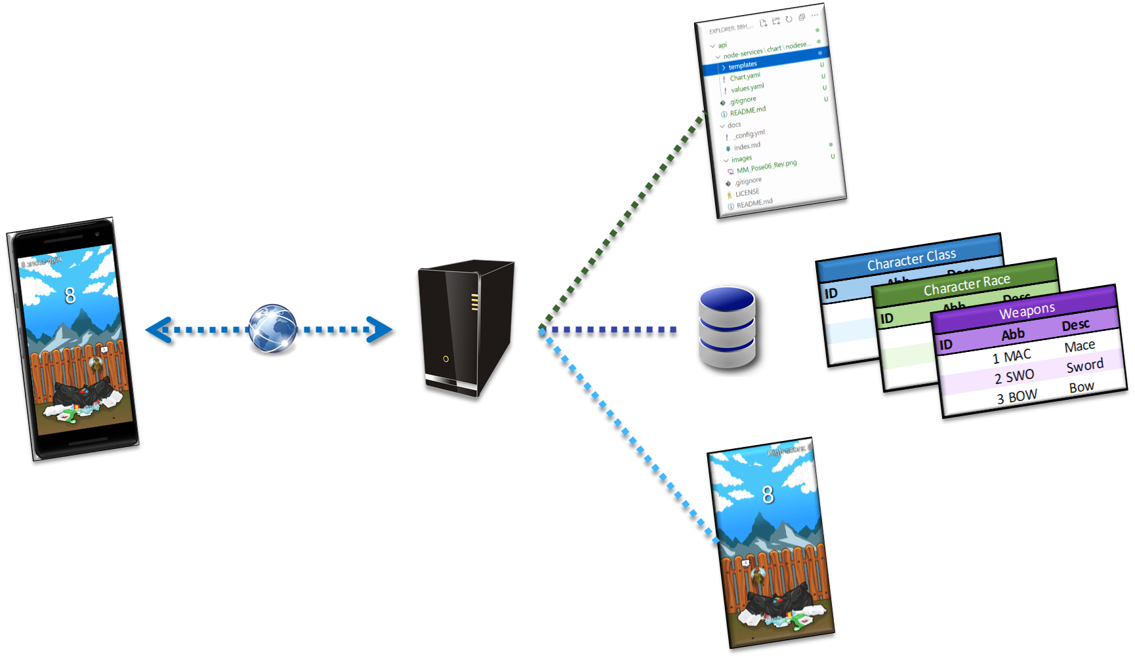
Cool_Application_01 has gone viral! Awesome, but now the real work starts.
Users on both app stores are finding bugs in the code and asking for new features
We enlist a few of our awesome friends to help tackle the bugs
Now we have source code conflict – both Sergio and Gabriela changed the same file, and Sergio’s changes overwrote Gabriela’s
The server we started with is getting overloaded with requests, and many users are complaining that they can’t access it
We need more server space and CPU.
Someone pointed out that the security of our application is sorely lacking
Hackers can login to the server and make changes to the file – we need to lock it down better

Slide 8






DevOps and the Cloud have your solutions!
Azure Firewall
Azure Database
for MariaDB
Kubernetes
Docker

Slide 9

A little more about source control
Commit 1
Commit 2
Commit 3
Commit 4
Commit 8
Images
Images
Images
Images
Background.png
Background.png
Background.png
Background.png
Title.jpeg
Title.jpeg
Title.jpeg
Title.jpeg
Cool_icon.ico
Cool_icon.ico
Cool_icon.ico
Cool_icon.ico
JS_CSS
JS_CSS
Banner.jpg*
Banner.jpg*
JS_CSS
JS_CSS
main.js
main.js*
Jquery.js
Jquery.js
main.js*
main.js*
Styles.css
Styles.css*
Jquery.js
Jquery.js
Index.html
Index.html*
Styles.css*
Styles.css*
Page1.html
Page1.html
Index.html*
Index.html*
Page2.html
Commit 5
Page2.html
Commit 6
Page1.html
Commit 7
Page2.html

Slide 10
Show & Tell
GitHub
Code base
Actions
Docker image in an action
Pages

Slide 11
Project – Create a Webpage by Forking the BBH_Demo Repository
Fork the repository
Set up pages
Make a small change to the code and commit to trigger an action to build the website
Make changes to the code
Commit changes to the code
Clear your browser cache
View the webpage
Bonus – use inspect element to see what the code is doing/make on the fly changes to see how to fix it.

Slide 12
Resources for Further Learning
Developer.Roblox.com
Free lessons on Roblox Studio, to design and build your own Roblox games
Scratch
A visual coding language designed for kids to learn how to code
Khan Academy
Coding lessons similar to the math lessons you may have done in school
CodeAcademy
Another free website for learning the basics of various programming languages
Github
Azure Free Account
Cloud-based infrastructure
Access to a number of free features, some features free for 12 months, + a $200 credit for paid applications

Slide 13
Appendix – Borrowed elements
Everi images:
Fintech: https://www.everi.com/fintech/
Games: https://www.everi.com/games/
Scenario mobile app:
https://github.com/kidding-with-android/langaw-game
Server image & Database image:
https://pngimg.com/images/electronics/server
WWW icon:
https://pixy.org/101088/
Azure icons:
http://code.benco.io/icon-collection/azure-icons/
GitHub icon:
https://github.com/logos
Docker icon:
https://icon-library.com/icon/docker-container-icon-7.html
Folder icon:
https://commons.wikimedia.org/wiki/File:Icons8_flat_folder.svg

Slide 14
Thank you!

